Slide 1


Darshan Rajeev Naik
naikdarshan221@gmail.com
WALMART
QTR-01 SALES DATA ANALYSIS USING MYSQL

Slide 2
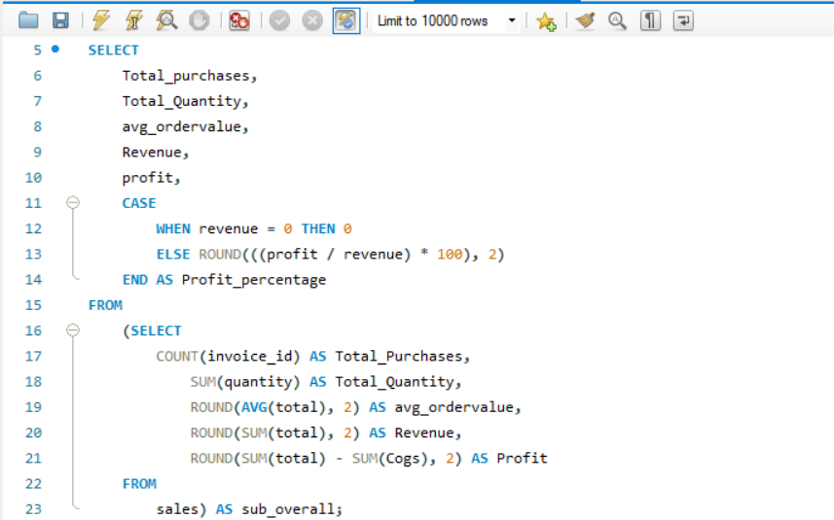

Key Metrics
naikdarshan221@gmail.com

Slide 3
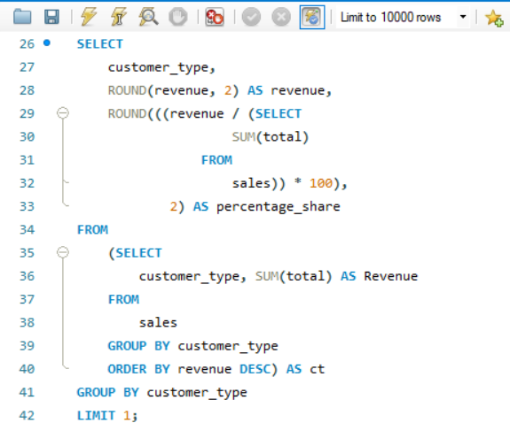

Top Customer Type
naikdarshan221@gmail.com

Slide 4
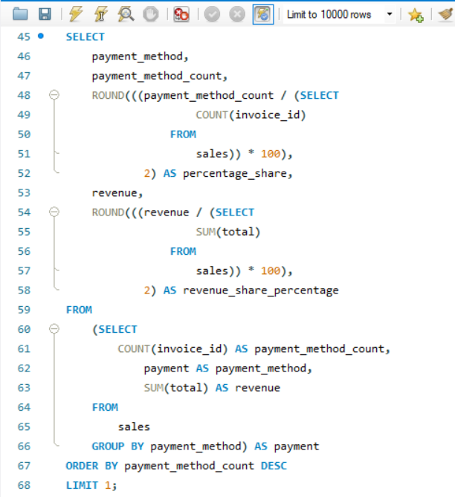

Most Preferred Payment Type
naikdarshan221@gmail.com

Slide 5
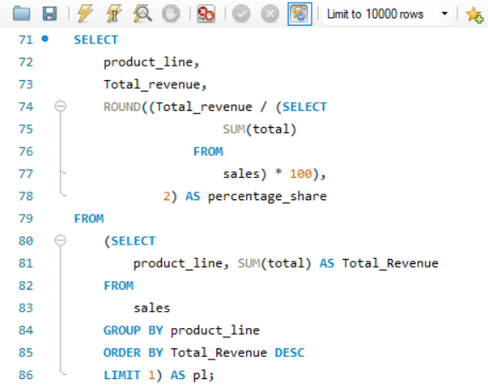

Top Selling Product Line
naikdarshan221@gmail.com

Slide 6
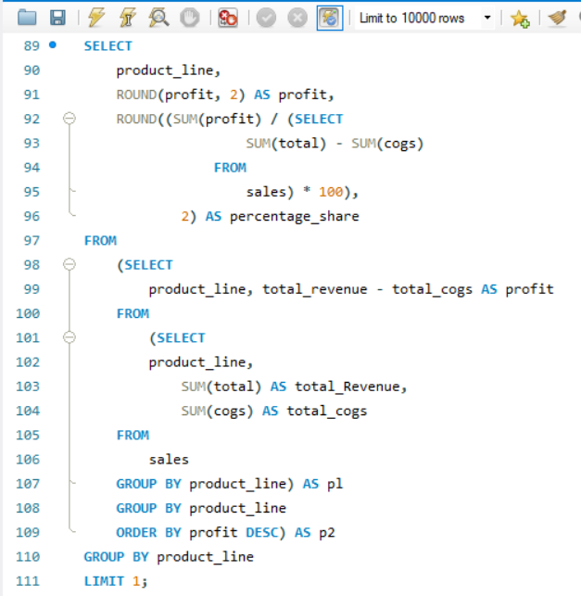

Most Profitable Product Line
naikdarshan221@gmail.com

Slide 7
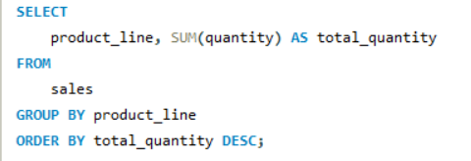
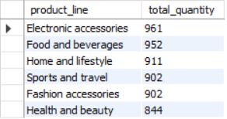
Product Line With Quantity Sold
naikdarshan221@gmail.com

Slide 8
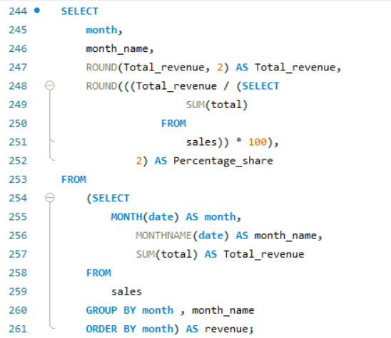
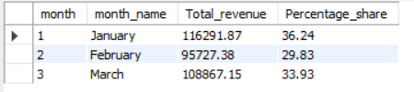
Month Wise Revenue Distribution
naikdarshan221@gmail.com

Slide 9
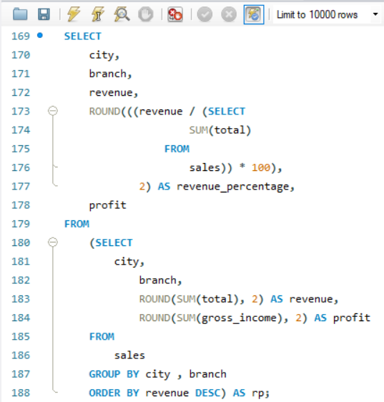
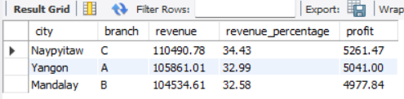
Branch Wise Revenue and Profit Distribution
naikdarshan221@gmail.com

Slide 10
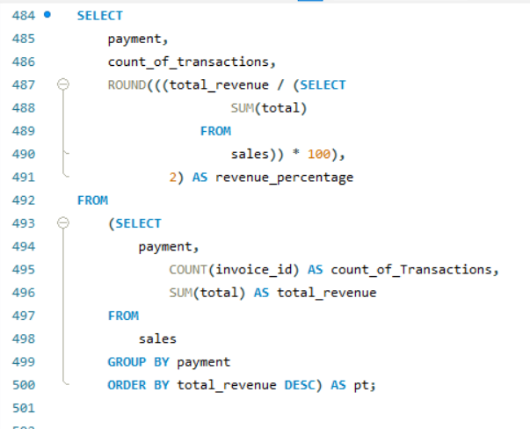

Distribution of Payment Method In Total Revenue
naikdarshan221@gmail.com

Slide 11
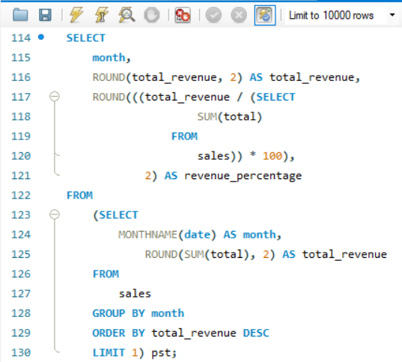

Peak Sales Month
naikdarshan221@gmail.com

Slide 12
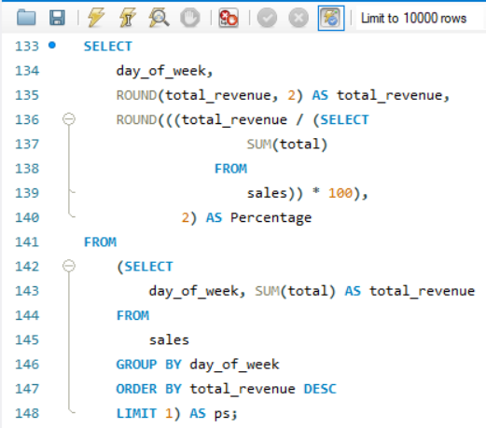

Peak Sales Day
naikdarshan221@gmail.com

Slide 13
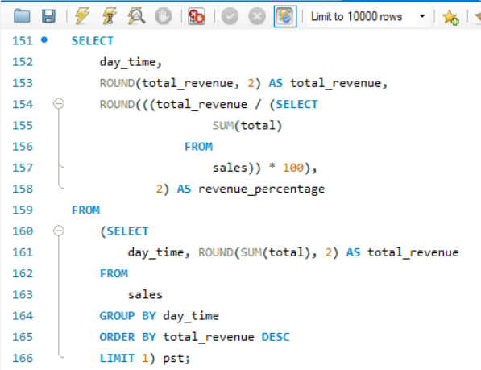

Peak Sales Day Time
naikdarshan221@gmail.com

Slide 14
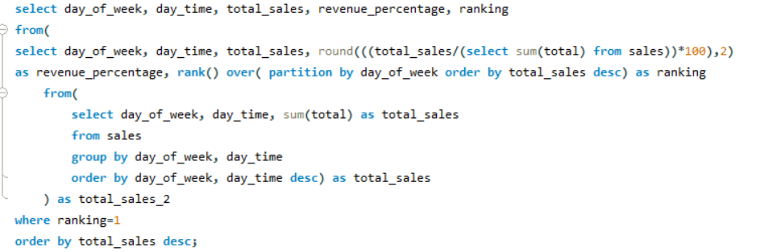
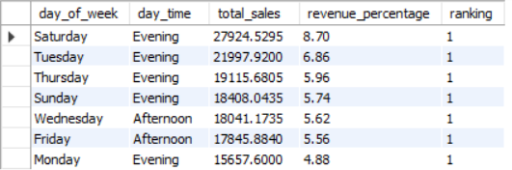
Peak Sales Time Shift on a Daily Basis
naikdarshan221@gmail.com

Slide 15
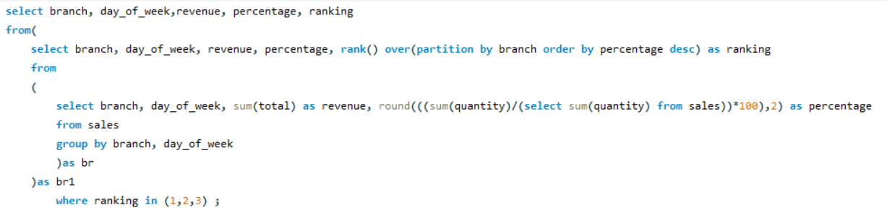
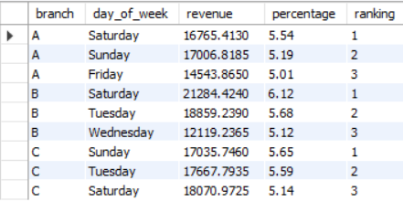
Top 3 Peak Sales Day Branch wise
naikdarshan221@gmail.com

Slide 16
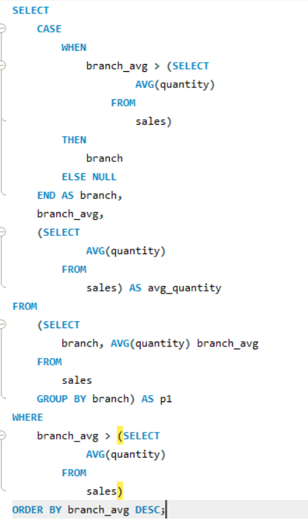

Branch Whose Average Quantity Sold Is More Than Average Quantity Sold
naikdarshan221@gmail.com

Slide 17
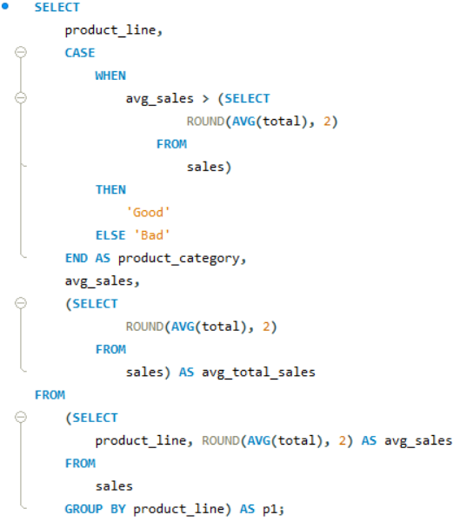
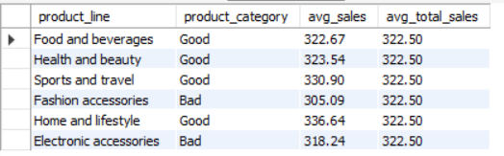
Naming Product Line as Good and Bad based on Average Sales
naikdarshan221@gmail.com

Slide 18
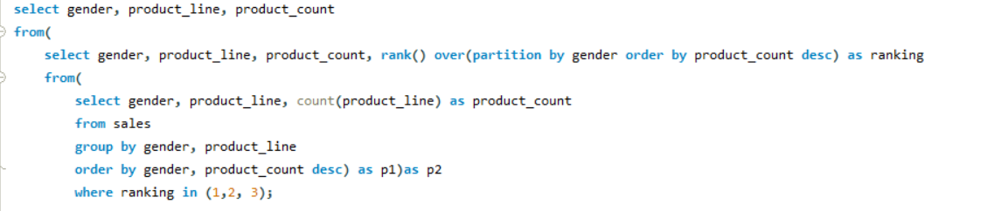
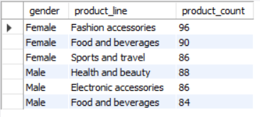
Gender Wise Product Preferences
naikdarshan221@gmail.com

Slide 19
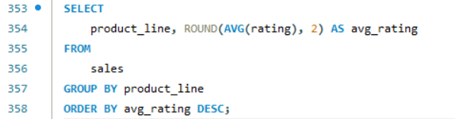
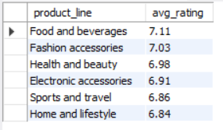
Product Line Wise Average Rating
naikdarshan221@gmail.com

Slide 20
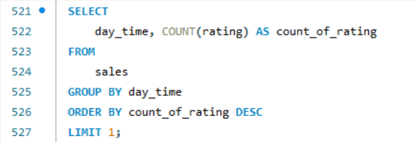

Time Of The Day Most Ratings Received
naikdarshan221@gmail.com

Slide 21
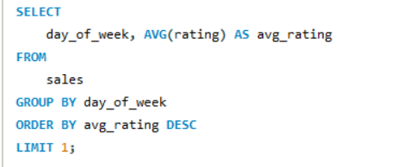

Highest Average Rated Day
naikdarshan221@gmail.com

Slide 22
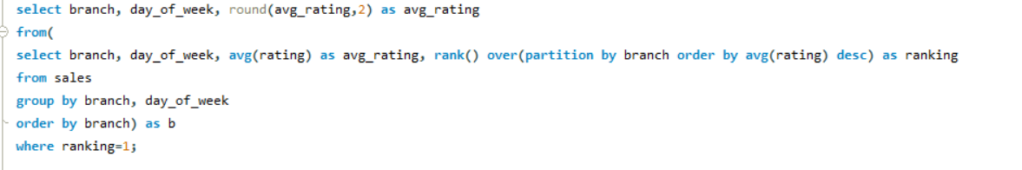
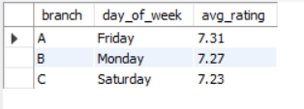
Day That Has Highest Average Rating Branch Wise
naikdarshan221@gmail.com

Slide 23
naikdarshan221@gmail.com
Thank You
Express your Views On Analysis
In Comment Section

